Slide 1

Agentic RAG System Architecture
Document Processing and Question Answering System
Author: Aniket Palarapu

Slide 2


System Overview
Multi-agent architecture for document processing
Vector-based retrieval system
AI-powered question answering
Asynchronous message passing
Support for multiple document formats

Slide 3
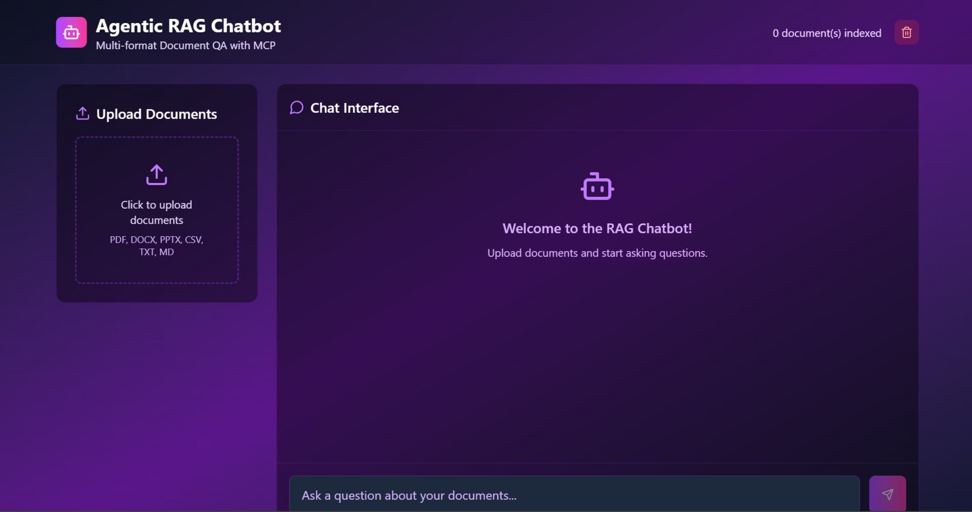
Implementation Images

Slide 4
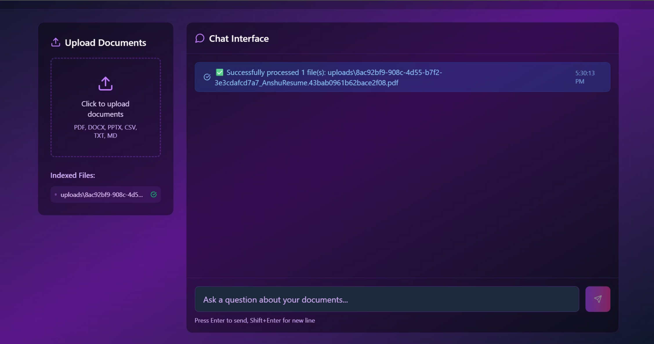

Slide 5
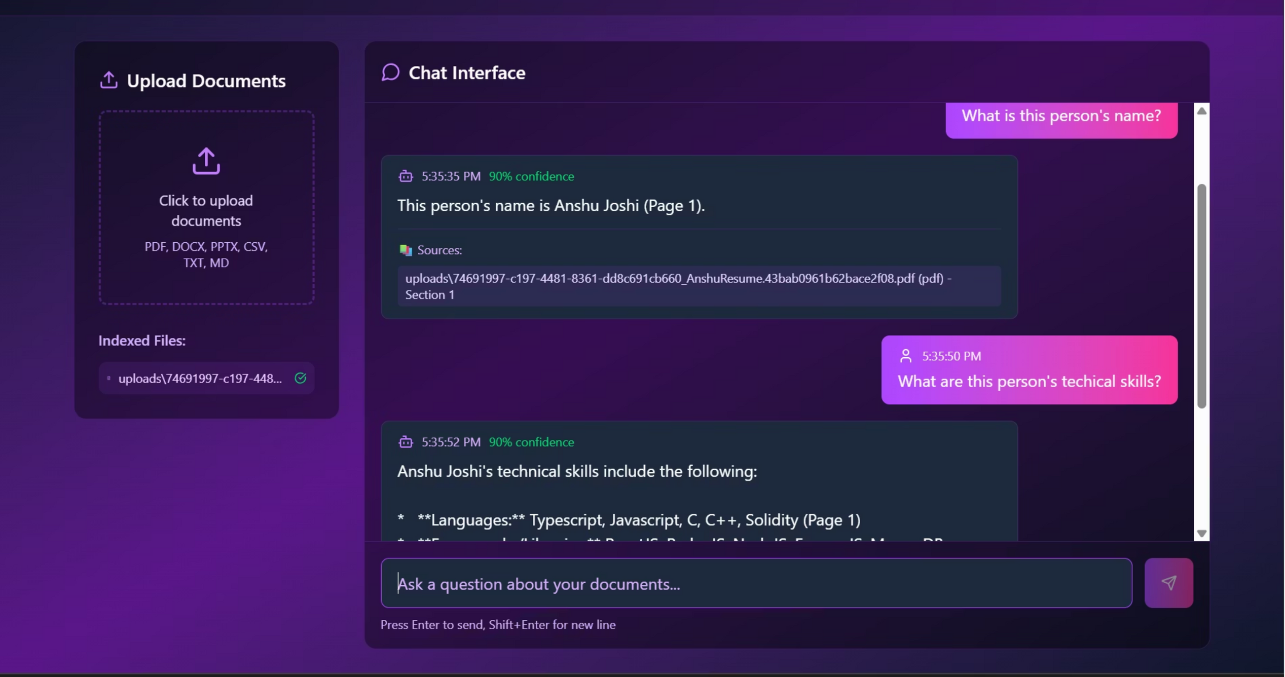

Slide 6
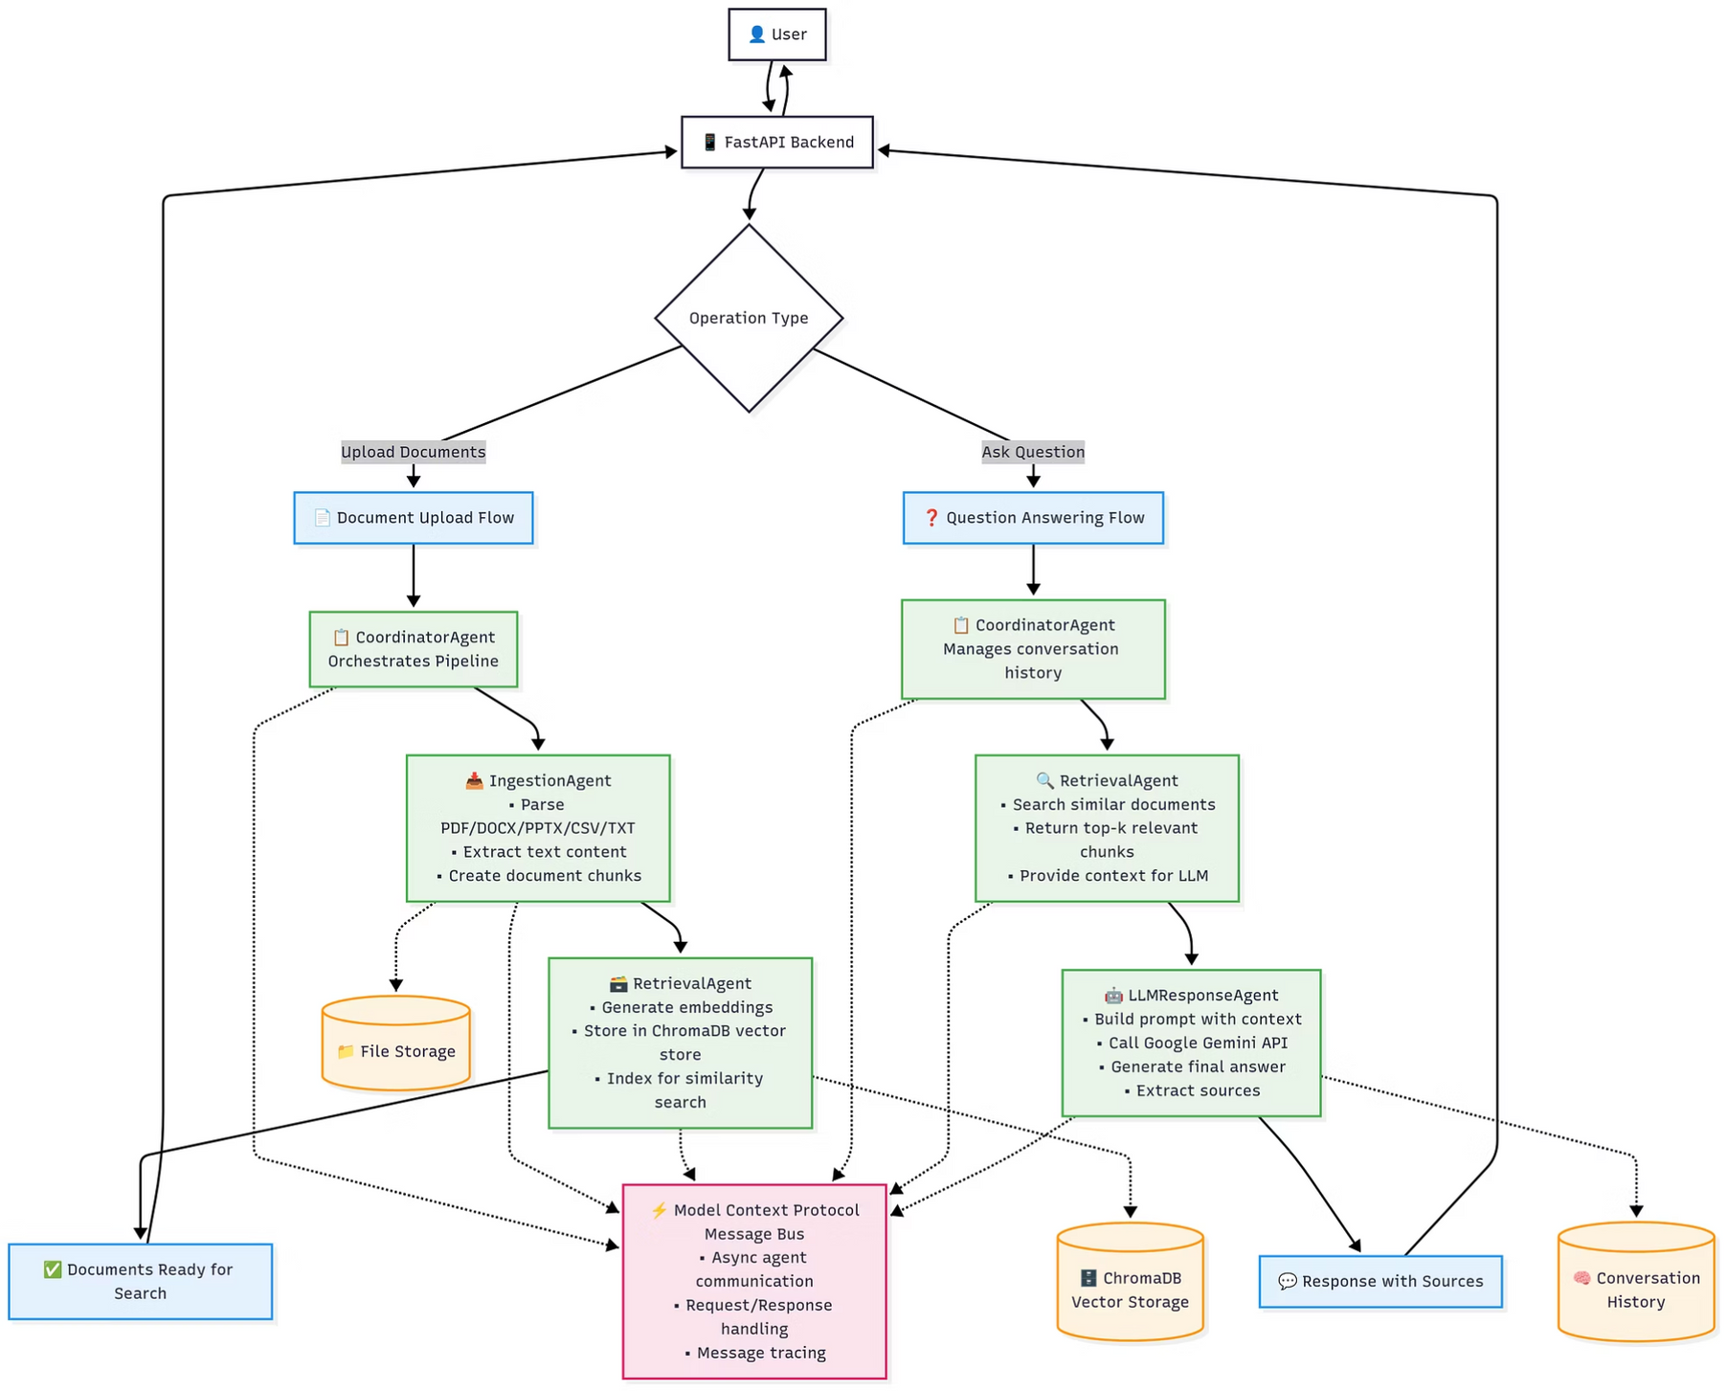
SYSTEM ARCHITECTURE

Slide 7





Message Flow Through System
Client requests processed through Coordinator Agent
Documents flow through Ingestion Agent to Vector Store
Questions trigger Retrieval and LLM Agents
All communication via Message Bus
Asynchronous message handling for reliability

Slide 8
Document Processing Pipeline
1
2
Upload
Parse
3
4
Vectorize
Store

Slide 9






Core Components
Message Bus
Ingestion Agent
Retrieval Agent
Central communication hub
Document processing
Vector search
LLM Agent
Coordinator Agent
Frontend
AI responses
Workflow orchestration
User Interface

Slide 10








Technology Stack
FastAPI
ChromaDB
Google Gemini
Backend framework
Vector storage
LLM
Python
ReactJS
Implementation
Frontend

Slide 11
Implementation Notes
Environment setup required
API key configuration needed
Storage space planning
Performance monitoring
Error handling
Potential Improvements
Additional document formats
Enhanced error handling
Performance optimization
Security features
Monitoring dashboard

Slide 12
Conclusion
Modular, scalable architecture
1
Efficient document processing
2
Context-aware responses
3
Robust error handling
4
Easy maintenance
5

